Slide 1
MINI project
Guided by: Mrs. Madhavi Nimkar
Presented By: Anveshika Singh(604)
Shruti Jadhav(620)
Prakruti Chavan(611)

Slide 2
Introduction
This mini project aims to analyze the performance of batsmen in cricket based on their strike rates and total runs. The dataset provided includes information about the total runs scored by each batsman and their corresponding strike rates. By examining these two factors, we can gain insights into the effectiveness and efficiency of different batsmen in terms of scoring runs.

Slide 3
Motivation
We have taken this project as we have a genuine interest and passion in the EDS subject. This project presents us the opportunities for personal growth and learning. By taking this project we can acquire new skills regarding how to handle datasets.

Slide 4
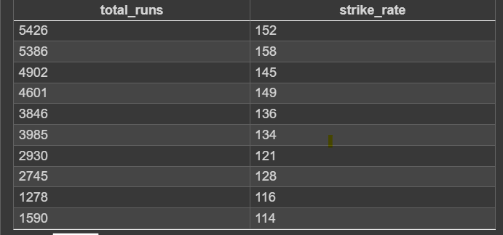
Details of Dataset

Slide 5
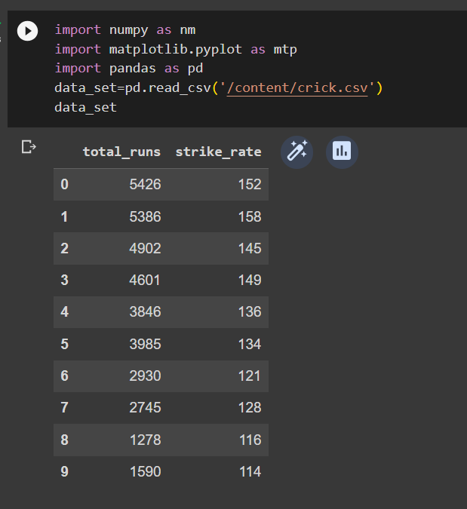
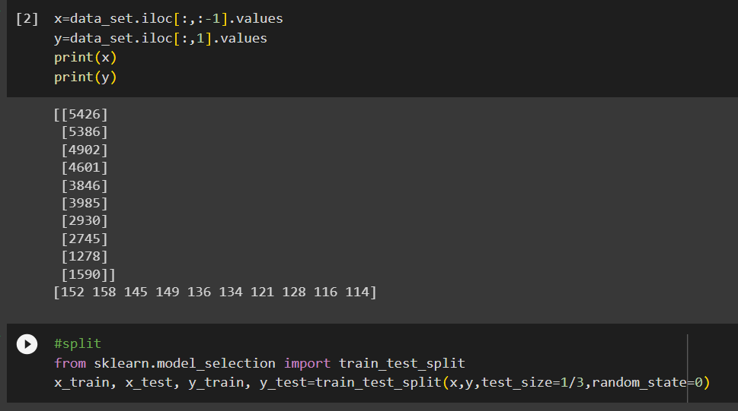
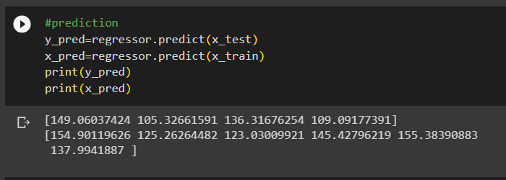
Data mANIPULATION

Slide 6
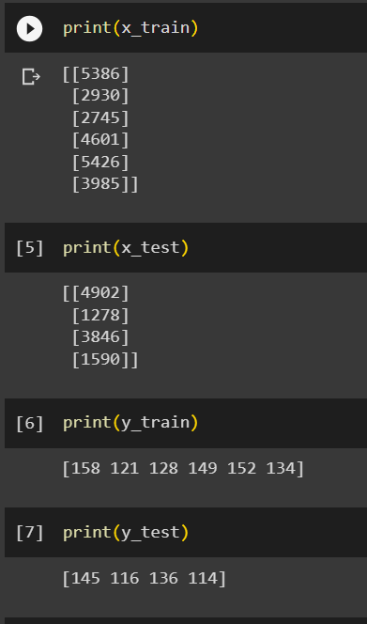
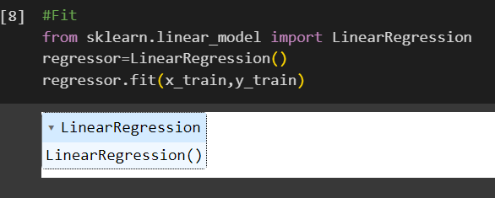
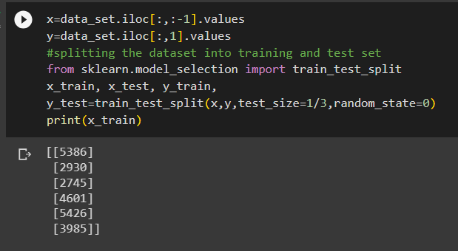
Data mANIPULATION

Slide 7
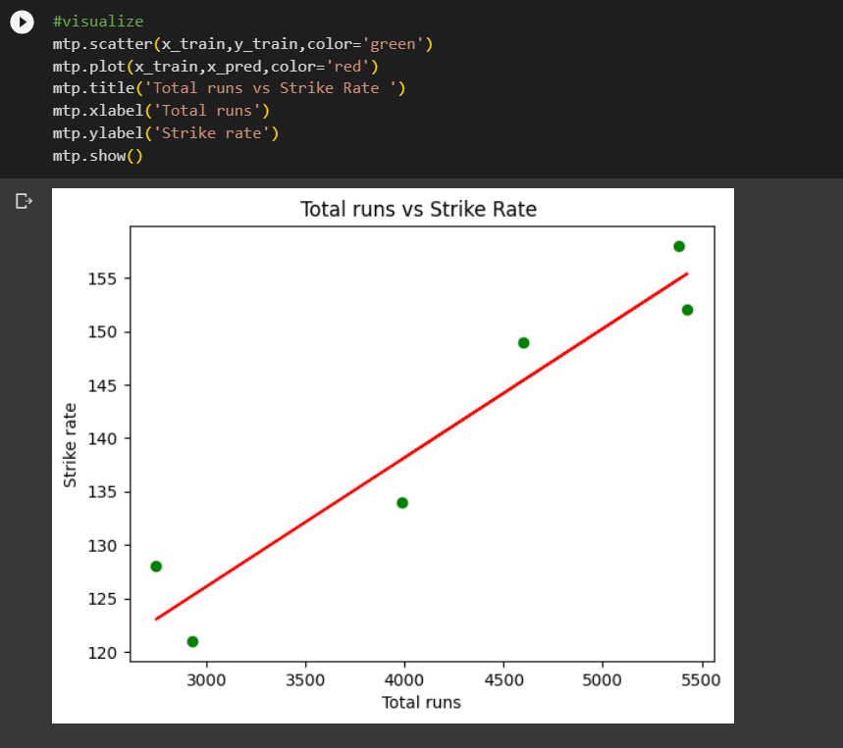
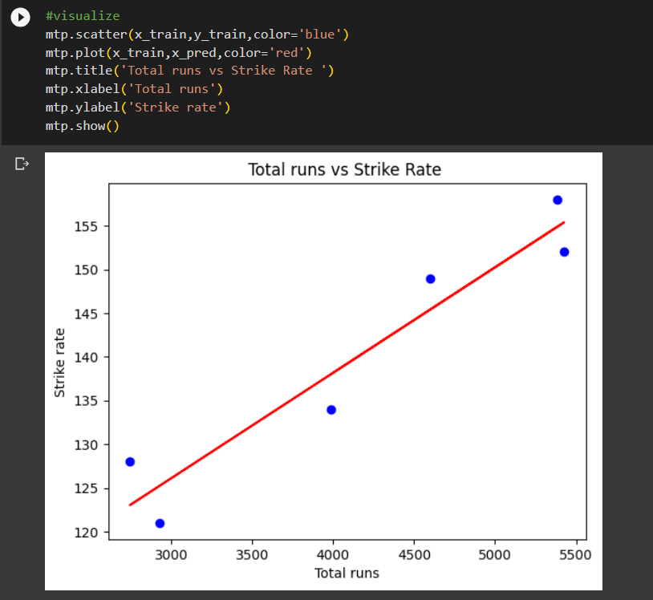
Data VISUALISATION

Slide 8
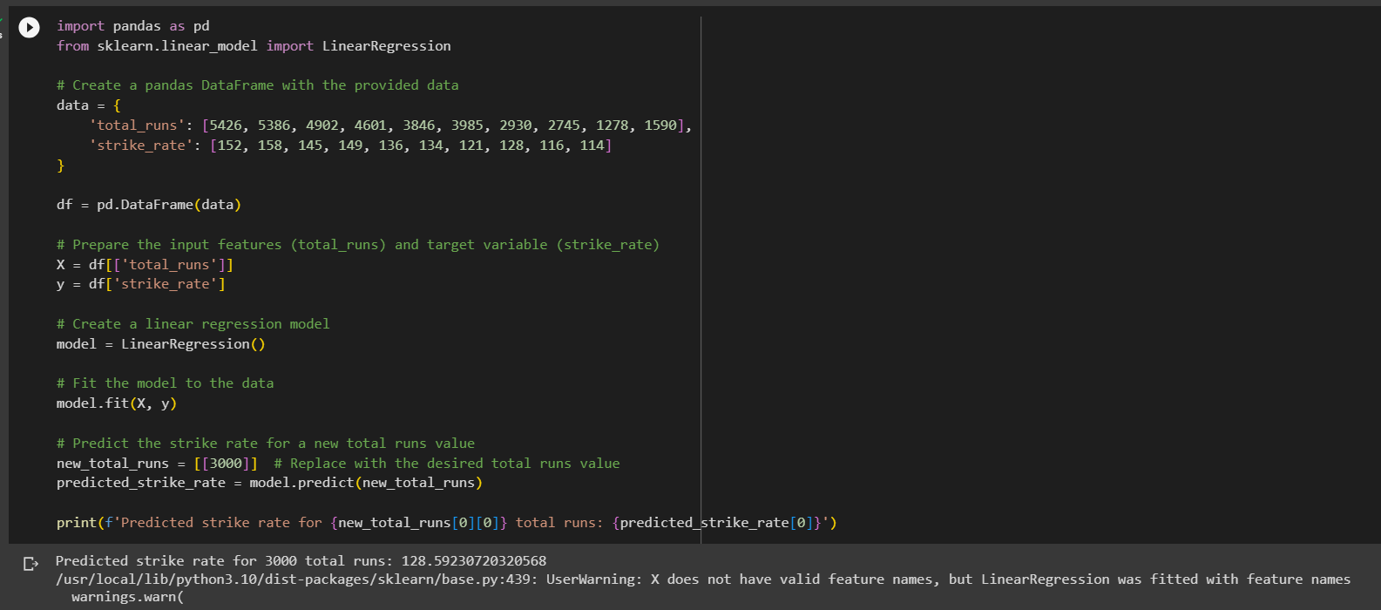
Predictive techniques(linear regression)

Slide 9
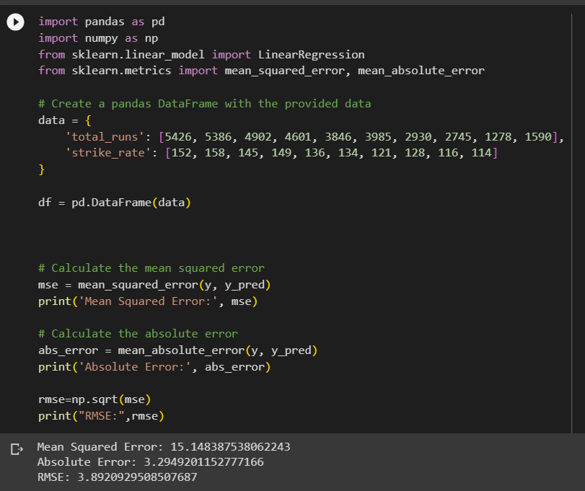
Predictive techniques(linear regression)

Slide 10
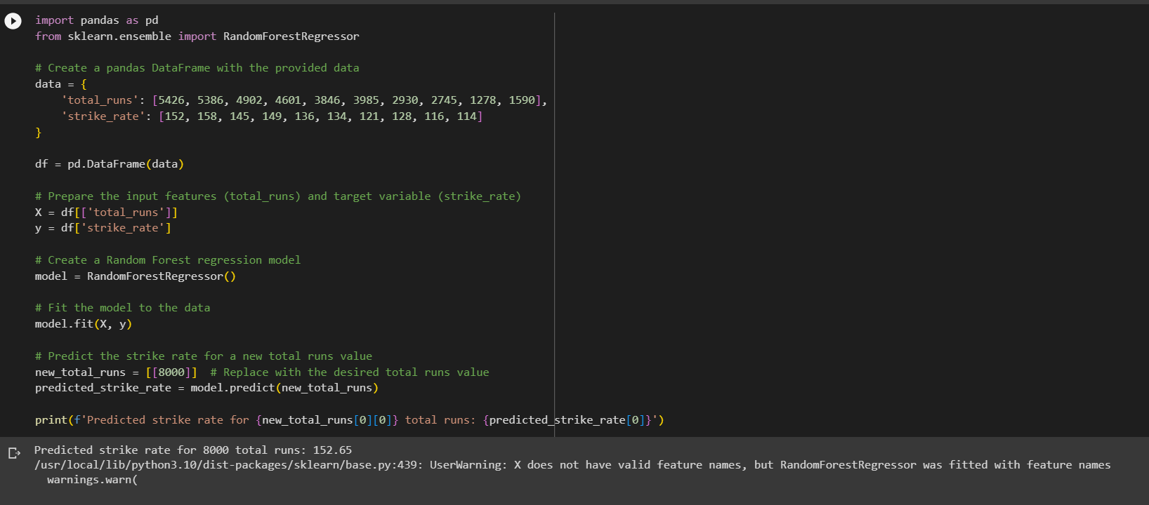
Predictive techniques(Random forest)

Slide 11
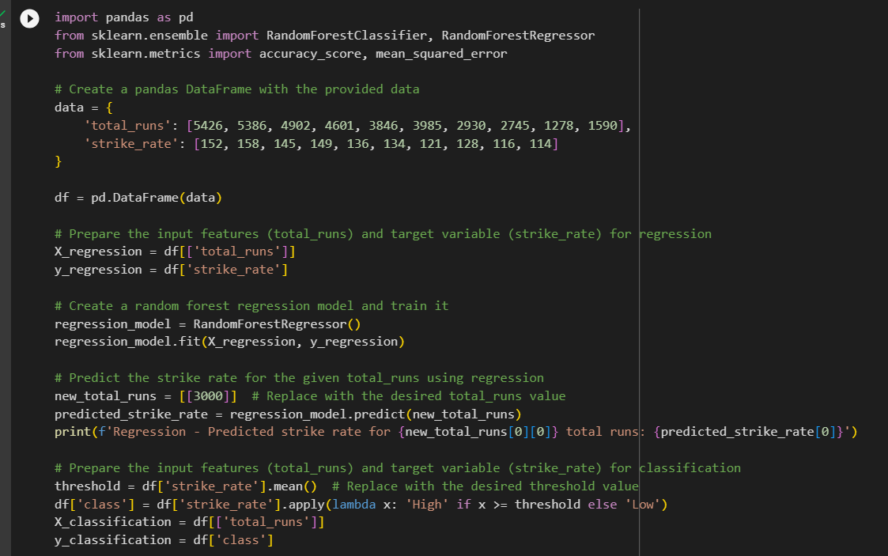
Predictive techniques(Random forest)

Slide 12
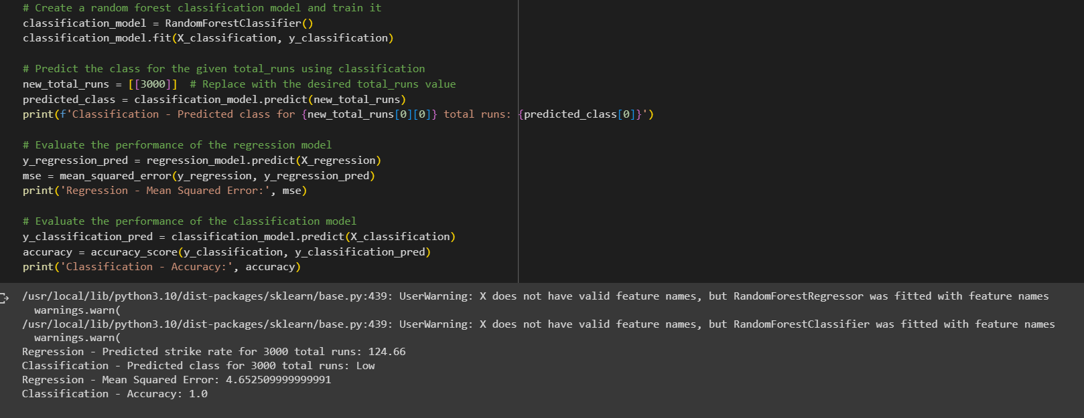
Predictive techniques(Random forest)

Slide 13
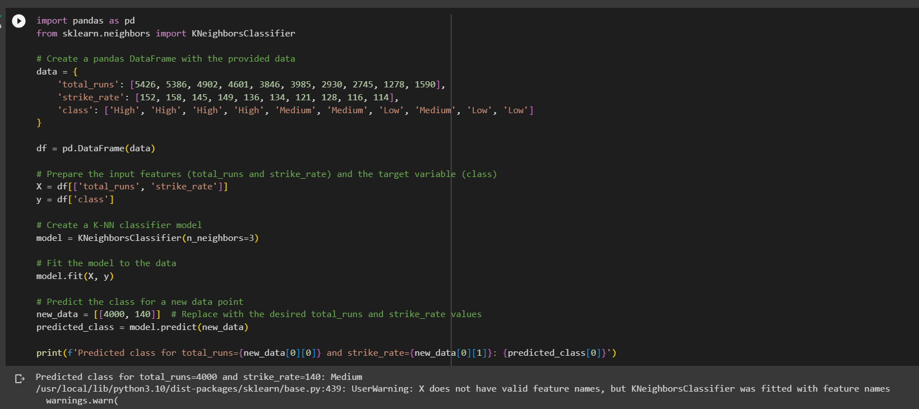
Predictive techniques(knn)

Slide 14
Application
In the mini project focused on batsmen with strike rates and total runs, several applications can be explored to gain insights and draw meaningful conclusions. Here are a few potential applications for the project:
Performance Ranking
Comparison of Playing Styles
Impact of Strike Rate on Match Outcomes
Trend Analysis
Player Comparison
Performance Prediction

Slide 15
Conclusion
In conclusion, the mini project focusing on batsmen with strike rates and total runs provides valuable insights into the performance and effectiveness of cricket players. By analyzing the dataset, we were able to gain several key findings:
Correlation between Total Runs and Strike Rates
Scoring Efficiency Assessment
Performance Comparison
Visualization of Data

Slide 16
THANK YOU

